Slide 1

Year 6
Miss Andrew and Miss O’Malley

Slide 2
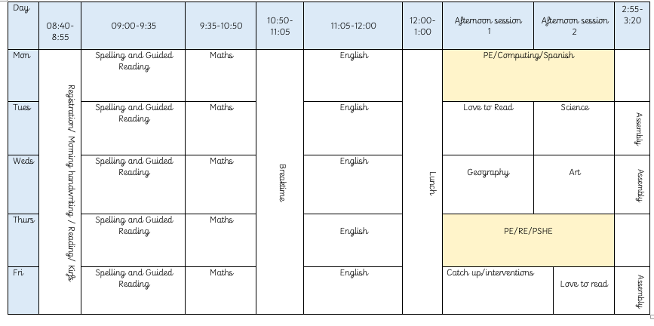
Notes:
Morning - interventions – important to be on time

Slide 3
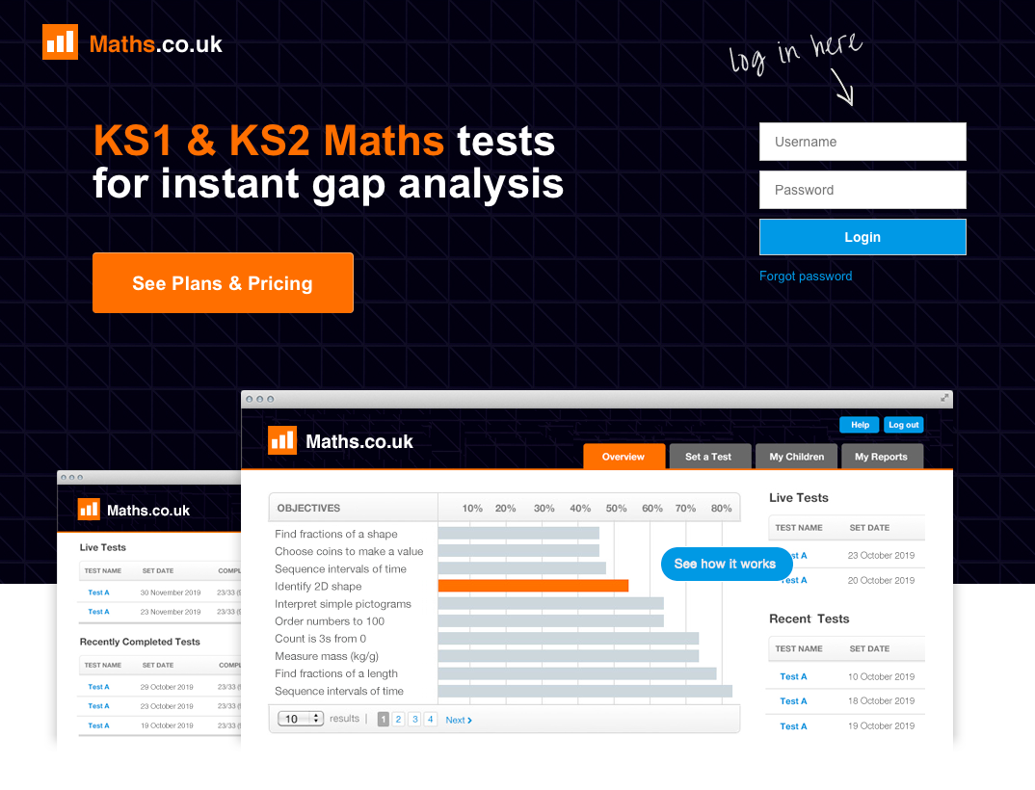

Slide 4


Slide 5
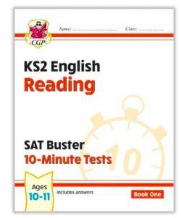


Slide 6
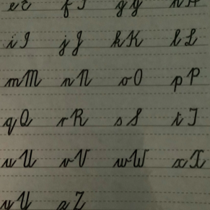
Handwriting

Slide 7

Clear Expectations
Effort
Home learning
Uniform
Appropriate PE kit

Slide 8
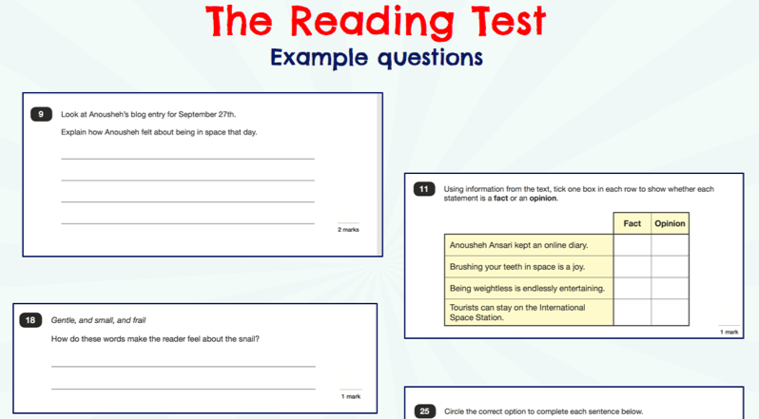

Slide 9
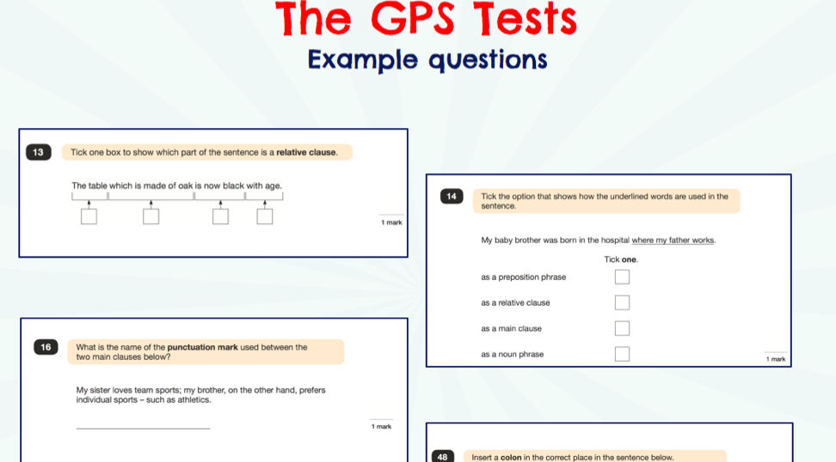

Slide 10
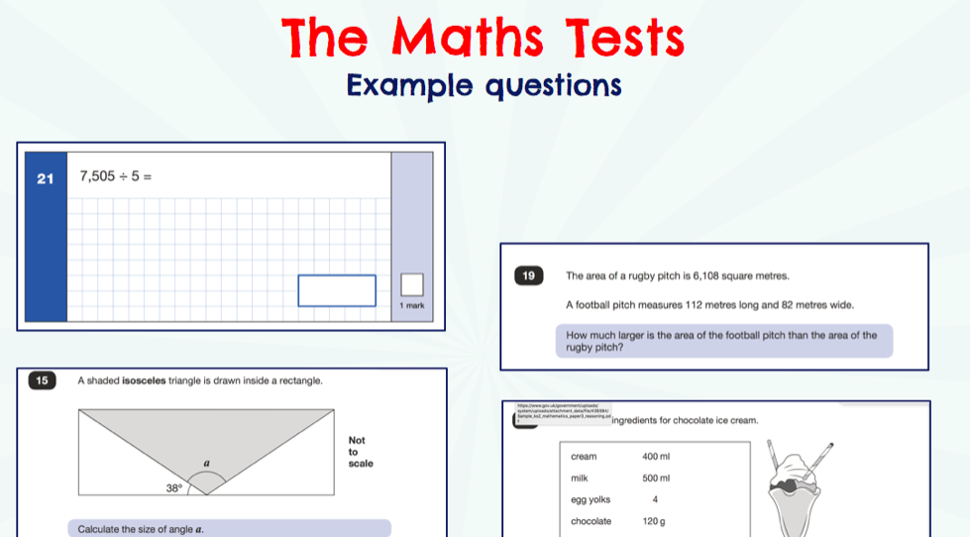

Slide 11
There are no writing or Science SATS test.
Writing and Science assessments will be formed from judgements made by me, looking at evidence from the children’s books which is collected over the course of the year.
I will moderate their assessments with other professionals to make sure there is a consistent standard across the country.
Final judgements will be reported to parents at the same time as the other assessment results.

Slide 12


Slide 13
How can I help my child?
Help children not to feel worried or pressured about SATS. All that is asked is that they try their best, but please reassure children that the SATS should not be causing anxiety. Do give lots of praise and encouragement!
Help children with organising their homework (including spellings and mental arithmetic) and support their reading for pleasure activities.
Help your child to have the best possible attendance at school.
Please speak to a member of staff if you have questions or concerns.

